Slide 2
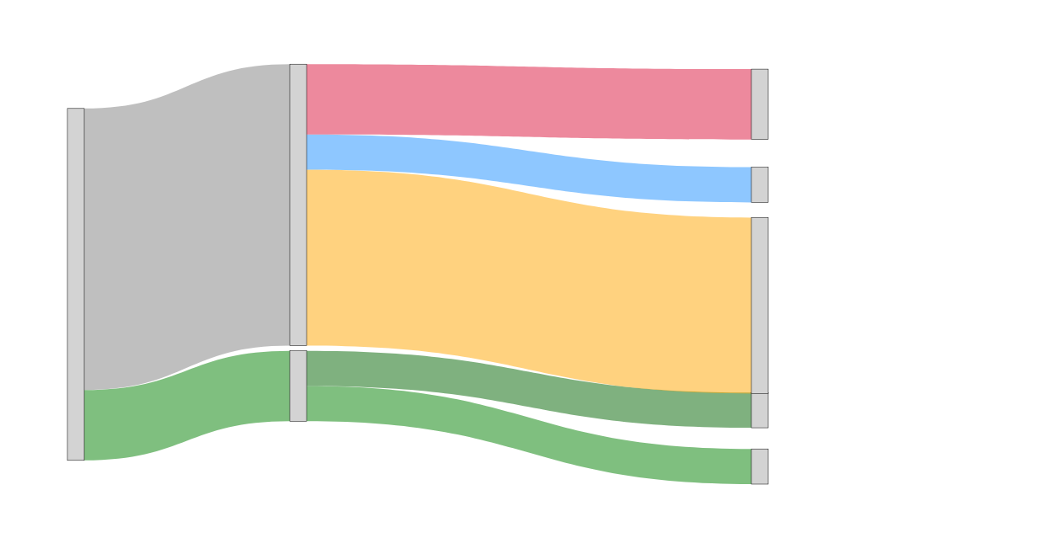
Housing Booms: When Early LTV Tightening Is Missed, Policymakers Pivot to Building Capital Buffers
No response at all
(10%)
In majority of cases LTV was not activated
Other than LTV or capital buffer
(10%)
Some kind of capital buffer was tightened later or the midst of boom
20 Housing boom episodes
(60%)
LTV was tightened in only 4 episodes
LTV + some capital buffer (10%)
LTV only (10% of cases)

